Slide 1

Introduction to Docker
Docker is a popular platform for developing and deploying applications. It allows developers to package their applications and their dependencies into portable containers, making it easier to move them between different environments.

Slide 2
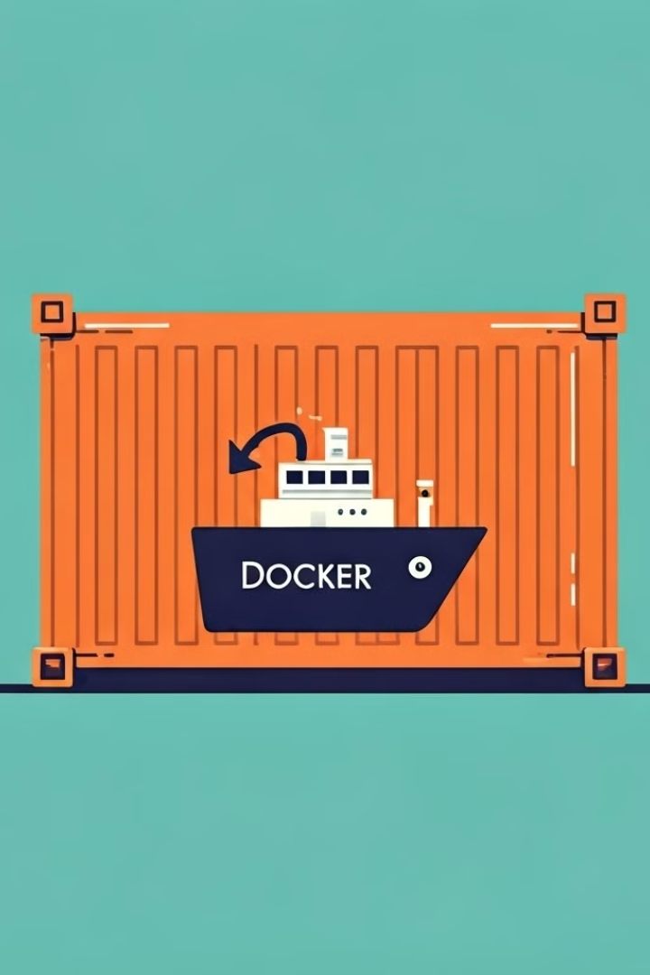
What is Docker?
Standardization
Isolation
Ensures applications run consistently regardless of the environment.
Containers are isolated from each other and the host system, preventing conflicts.
Efficiency
Docker uses lightweight containers, reducing resource consumption compared to virtual machines.

Slide 3
Docker Containers
Lightweight
Portable
Scalable
Containers share the host operating system kernel, reducing overhead.
Containers can be moved between different environments without modification.
Containers can be easily scaled up or down to meet changing demands.

Slide 4

Docker Images
1
Base Image
The foundation of an image, typically containing the operating system.
2
Intermediate Layers
Each change made to the image creates a new layer, allowing for efficient updates.
3
Final Image
The complete image containing the application and its dependencies.

Slide 5




Docker Networking
Container-to-Container Communication
Containers within the same network can communicate with each other directly.
Bridge Networking
Containers share a virtual network interface, enabling communication between containers.
Host Networking
Containers use the host's network interface, providing direct access to the host network.

Slide 6
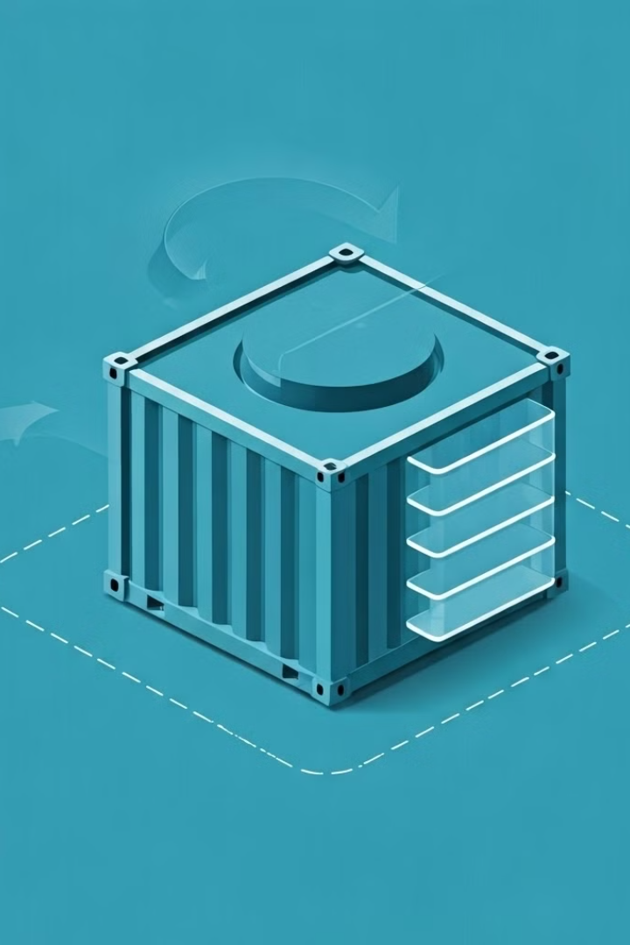



Docker Volumes
Data Persistence
Volumes store data separately from the container, ensuring data is not lost when the container is removed.
Data Sharing
Multiple containers can share the same volume, allowing them to access and modify the same data.
Data Backup
Volumes can be easily backed up and restored, providing data protection and disaster recovery capabilities.

Slide 7

Docker Compose
1
Multi-Container Applications
2
Configuration Management
3
Simplified Deployment
A single command can start, stop, and rebuild the entire multi-container application.
Docker Compose allows defining and managing multiple containers as a single unit.
Compose uses a YAML file to define the application's services, networks, and volumes.

Slide 8

Conclusion and Q&A
Docker has become an essential tool for modern software development. It simplifies application packaging, deployment, and scaling, while providing benefits like isolation, portability, and efficiency.

